Slide 1

High Impact Skills Development Program
in Artificial Intelligence, Data Science, and Blockchain
Module 1: AI Fundamentals
Classifier Comparison
Instructors: Dr Riaz Ud Din / Dr Latif Anjum
NUST – SEECS

Slide 2
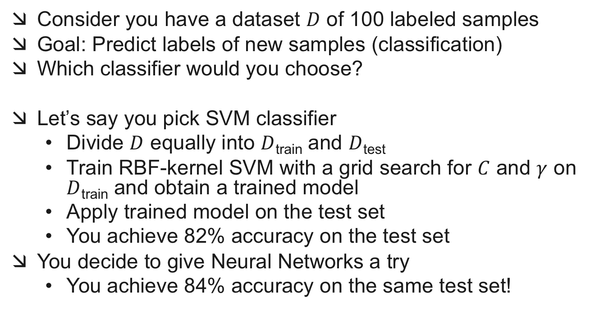
Classifier Comparison
Consider you have a dataset $D$ of 100 labeled samples
Goal: Predict labels of new samples (classification)
Which classifier would you choose?
Let’s say you pick SVM classifier
Divide $D$ equally into $D$_{train} and $D$_{test}
Train RBF-kernel SVM with a grid search for $C$ and $γ$ on $D$_{train} and obtain a trained model
Apply trained model on the test set
You achieve 82% accuracy on the test set
You decide to give Neural Networks a try
You achieve 84% accuracy on the same test set!
Is 84% > 82% ?
Are Neural Networks more suitable for this dataset than SVMs?

Slide 3
Statistical Significance
Is an observed difference in performance real or happening by chance?
You toss a coin 5 times
You get 2 Heads and 3 Tails
Can you conclude that the coin is more likely to produce tails?
You toss a coin 50,000 times
You get 20,000 Heads and 30,000 Tails
Can you now conclude that the coin is more likely to produce tails?

Slide 4
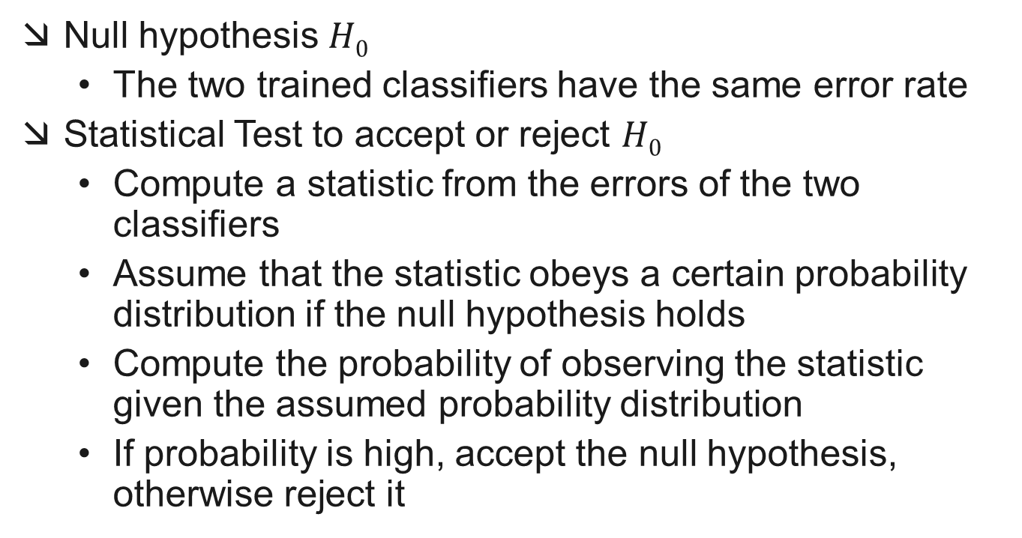
Statistical Hypothesis Testing
Null hypothesis $H0$
The two trained classifiers have the same error rate
Statistical Test to accept or reject $H0$
Compute a statistic from the errors of the two classifiers
Assume that the statistic obeys a certain probability distribution if the null hypothesis holds
Compute the probability of observing the statistic given the assumed probability distribution
If probability is high, accept the null hypothesis, otherwise reject it

Slide 5
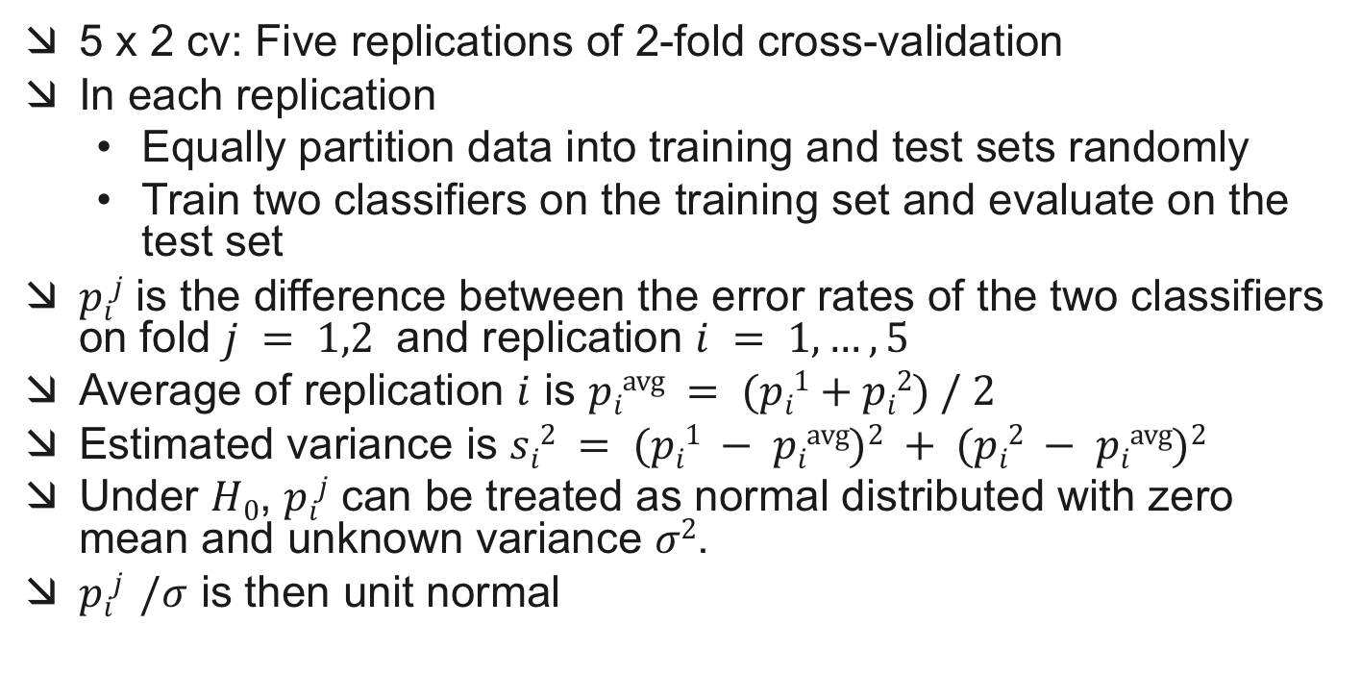
5 x 2 cv F Test
5 x 2 cv: Five replications of 2-fold cross-validation
In each replication
Equally partition data into training and test sets randomly
Train two classifiers on the training set and evaluate on the test set
$pij$ is the difference between the error rates of the two classifiers on fold $j = 1,2$ and replication $i = 1,…,5$
Average of replication $i$ is $pi\text{avg} = (pi1+pi2) / 2$
Estimated variance is $si2 = (pi1 − pi\text{avg})2 + (pi2 − pi\text{a}\text{vg})2$
Under $H0$, $pij$ can be treated as normal distributed with zero mean and unknown variance $σ2$.
$pij /σ$ is then unit normal

Slide 6
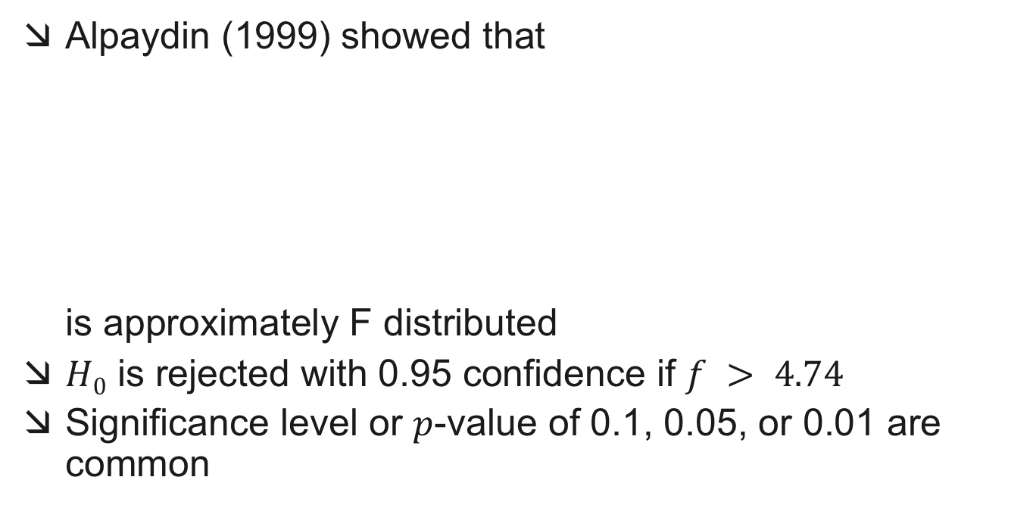

5 x 2 cv F Test
Alpaydin (1999) showed that is approximately F distributed
$H0$ is rejected with 0.95 confidence if $f > 4.74$
Significance level or $p$-value of 0.1, 0.05, or 0.01 are common

Slide 7
Comparison over Multiple Datasets
Averaging over datasets
Drawbacks:
Error rates in different domains are not commensurable
Outliers have a major impact
Underlying assumptions are often not satisfied

Slide 8
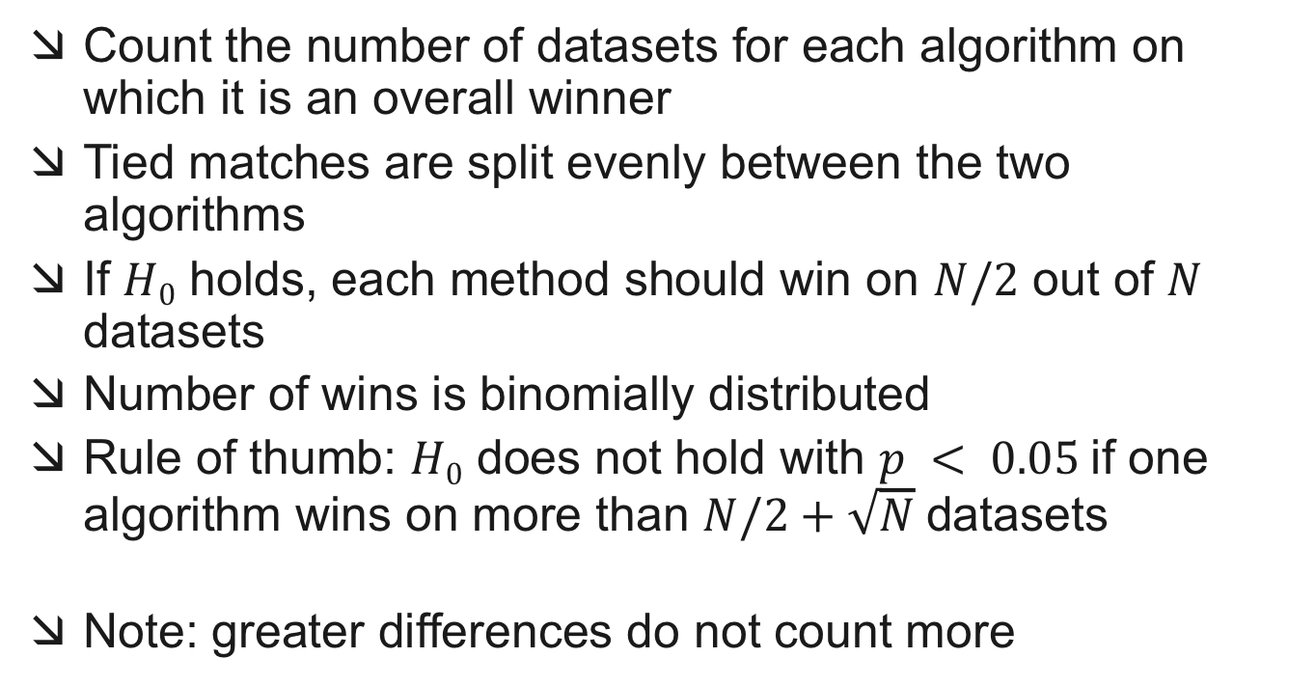
Sign Test
Count the number of datasets for each algorithm on which it is an overall winner
Tied matches are split evenly between the two algorithms
If $H0$ holds, each method should win on $N/2$ out of $N$ datasets
Number of wins is binomially distributed
Rule of thumb: $H0$ does not hold with $p < 0.05$if one algorithm wins on more than $N/2+\sqrt{N}$datasets
Note: greater differences do not count more
https://forms.gle/c5rtKthxk6sXcu6E8

Slide 9
Quiz
https://forms.gle/c5rtKthxk6sXcu6E8

